Slide 1

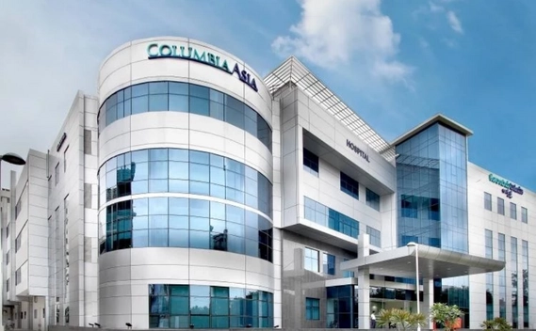
Columbia Asia Hospital Analysis
Presented By: Kiran H D

Slide 2

Content Overview
Introduction
Objectives with Problem Statement
Data Overview
Methodology
Analysis and Key finding
Strategic Recommendations
Conclusion

Slide 3
Introduction
Columbia Asia Hospital is committed to delivering quality healthcare while optimizing its operations. In this project, I analyze hospital data to uncover insights on revenue generation, patient satisfaction, and departmental efficiency. By understanding key metrics, I aim to provide actionable recommendations that can enhance patient experience and improve the hospital’s overall performance.
Key Focus Areas:
Assessing the hospital's revenue streams and identifying high-revenue departments.
Analyzing patient satisfaction scores across demographics and departments.
Identifying departments with high patient volume for potential staffing needs.
Developing strategies for targeted patient discounts to improve satisfaction and loyalty.

Slide 4
Objectives
To analyze the hospital’s revenue streams and identify departments that contribute most to overall income.
To evaluate patient satisfaction scores across demographics and departments to understand key drivers of patient experience.
To assess departmental demand and identify potential areas for staffing improvements.
To provide actionable strategies and recommendations for targeted discounts and improved patient engagement.

Slide 5
Problem Statement
Columbia Asia Hospital is focused on optimizing its operational performance and enhancing patient satisfaction. The hospital seeks a comprehensive analysis to identify revenue-driving departments, understand patient demographics, and evaluate patient satisfaction across various age and racial groups. Additionally, assessing patient wait times, discount eligibility, and department-wise demand is crucial for creating effective strategies to improve patient engagement and streamline hospital services.

Slide 6
Data Overview
Data Source:
The dataset includes comprehensive records of patient visits, doctor referrals, and billing information from Columbia Asia Hospital.
Key tables, such as doctor_patients_data and hospital_er, capture details on patient demographics, appointment fees, satisfaction scores, and wait times, offering a full view of hospital operations and patient experience.
Tools Used:
SQL for data querying and extraction.
Power BI for data visualization and insights generation.

Slide 7
Methodology
Step 1: Data Extraction & Preprocessing
Extract and clean data using Excel & SQL.
Aggregate metrics on patient demographics, billing, referrals, and satisfaction.
Step 2: Patient & Department Analysis
Analyze patient satisfaction by age, race, and department.
Evaluate department performance based on revenue, patient volume, and wait times.
Step 3: Financial & Operational Insights
Assess revenue by department and identify staffing needs.
Analyze correlations between wait times and satisfaction to identify key experience factors.
Step 4: Recommendations
Recommend discounts and staffing improvements to boost satisfaction and efficiency.
Suggest engagement initiatives based on satisfaction scores to enhance loyalty.

Slide 8
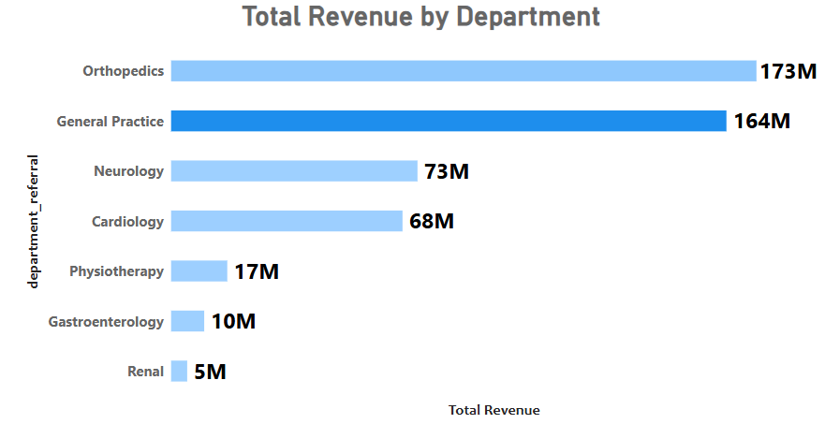
Total Revenue by Department
The Orthopedics Department recorded the highest total revenue among all departments, generating 173 million.
The Renal Department had the lowest total revenue, contributing just 5 million.

Slide 9
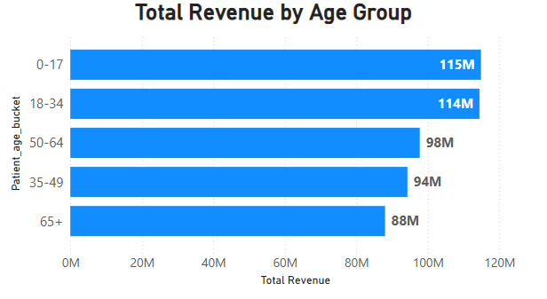
Total Revenue by Age Group
The age group 0-17 generated the highest revenue, totaling 115 million. Followed by the 18-34 age group with 114 million.
The lowest revenue was recorded in the 65+ age group, contributing 88 million.

Slide 10
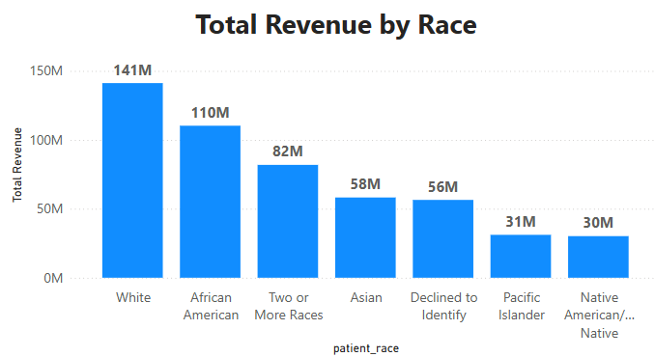
Total Revenue by Race
The White demographic generated the highest revenue, contributing 141 million to the government, followed by African Americans with 110 million.
The Native American demographic recorded the lowest revenue, contributing 30 million.

Slide 11
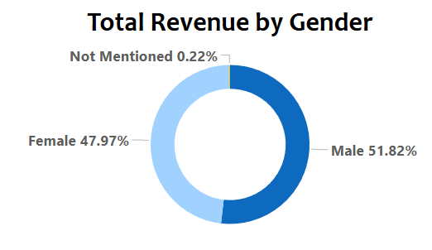
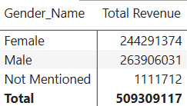
Total Revenue by Gender
Males generated the highest revenue, contributing 263.9 million (51.82%), followed by Females with 244.3 million (47.97%).
The Not Mentioned category contributed the remaining 1 million.

Slide 12
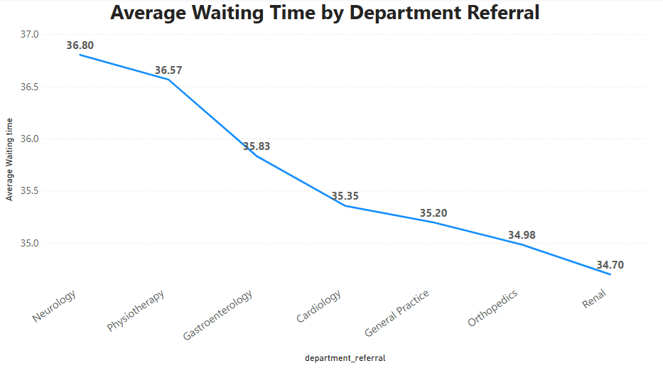
Department-Wise Average Waiting Time
The Neurology Department has the highest average waiting time of 36.80 minutes, followed closely by Physiotherapy with 36.57 minutes.
The Renal Department has the lowest average waiting time of 34.70 minutes.

Slide 13
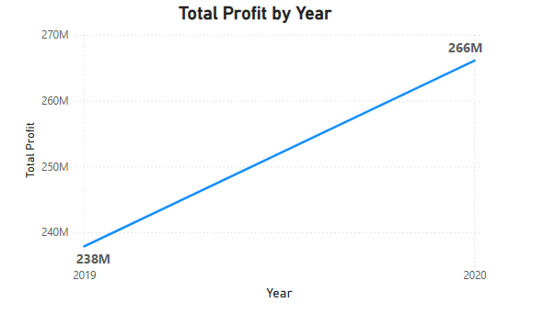
Total Profit by Year
In 2019, the total profit was 238 million, with the peak profit recorded in June at 30.2 million.
In 2020, the total profit increased to 266 million, with the highest profit in January at 29.9 million.

Slide 14
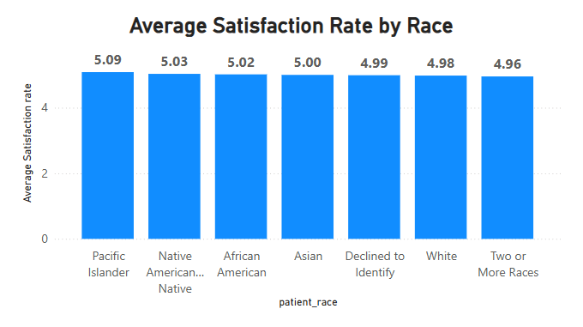
Race-Wise Average Satisfaction Rate
The highest average satisfaction score is among Pacific Islanders at 5.09, followed by Native Americans at 5.03.
The lowest average satisfaction score is 4.96.

Slide 15
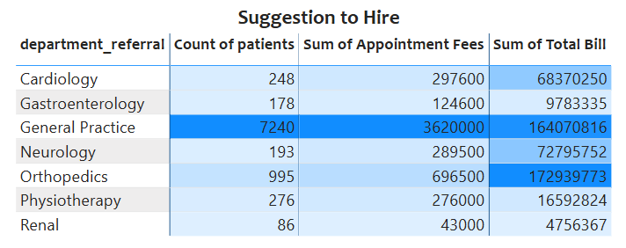
Suggestions for Hiring
General Practice: With the highest demand of 7,240 patients, 3.62M in appointment fees, and 164.07M total bill, this department is the primary choice for new hires.
Orthopedics: If General Practice is not prioritized, the next best option is Orthopedics, with 995 patients, 696.5K in appointment fees, and 172.94M total bill, indicating strong revenue potential.

Slide 16
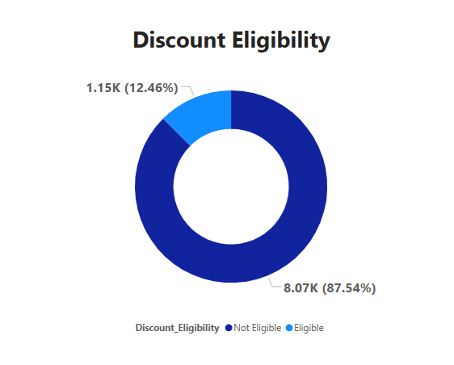
Discount Eligibility Analysis
Out of 9,216 patients, 12.46% are eligible for a discount, based on spending over 10,000 and a satisfaction score above 6.
The remaining 87.54% of patients are not eligible for the discount.

Slide 17
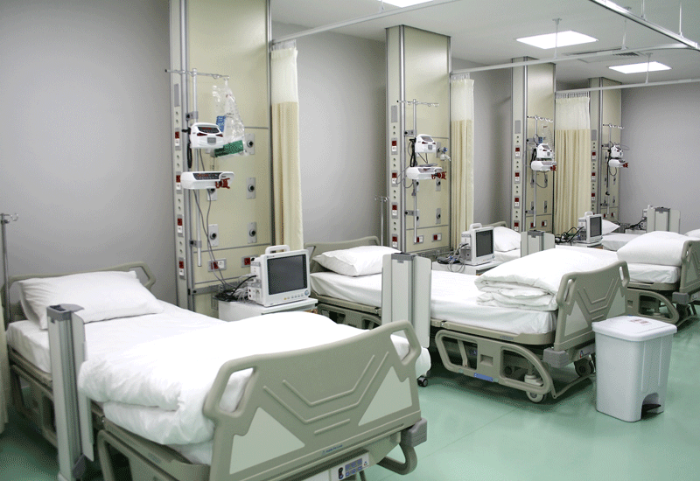
Strategic Recommendations
Enhance High-Demand Department Efficiency
Insight: High volume in General Practice and Orthopedics may cause bottlenecks and longer wait times, affecting satisfaction.
Recommendation:
Hire more staff in high-demand departments.
Implement improved scheduling and queue management to reduce wait times and boost efficiency.

Slide 18
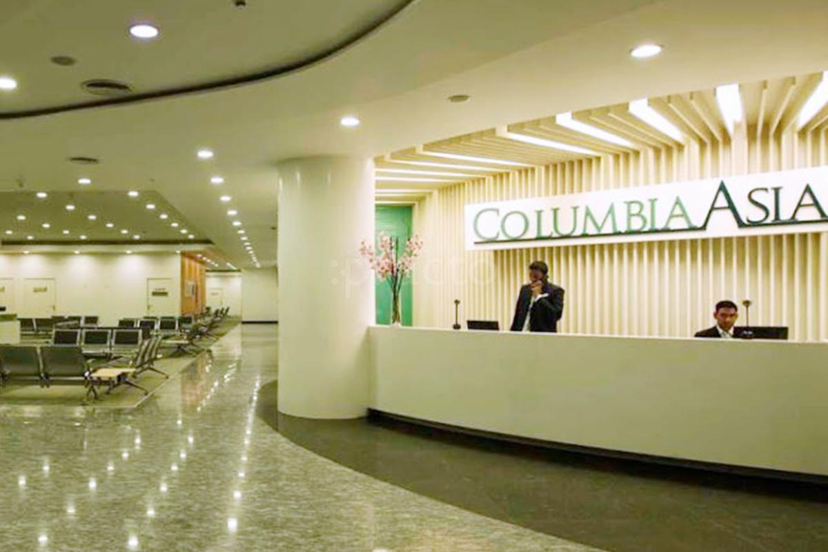
Strategic Recommendations
2. Tailored Patient Satisfaction Initiatives
Insight: Satisfaction varies across age and race, with some groups reporting lower scores.
Recommendation:
Develop targeted engagement strategies for low-scoring demographics.
Customize services and communication for a more personalized experience.

Slide 19

Strategic Recommendations
3. Optimize Discount Strategy for Patient Retention
Insight: Medium to high discounts boost patient satisfaction.
Recommendation:
Expand discounts for patients with high out-of-pocket costs.
Introduce loyalty and follow-up visit discounts to encourage repeat visits.

Slide 20
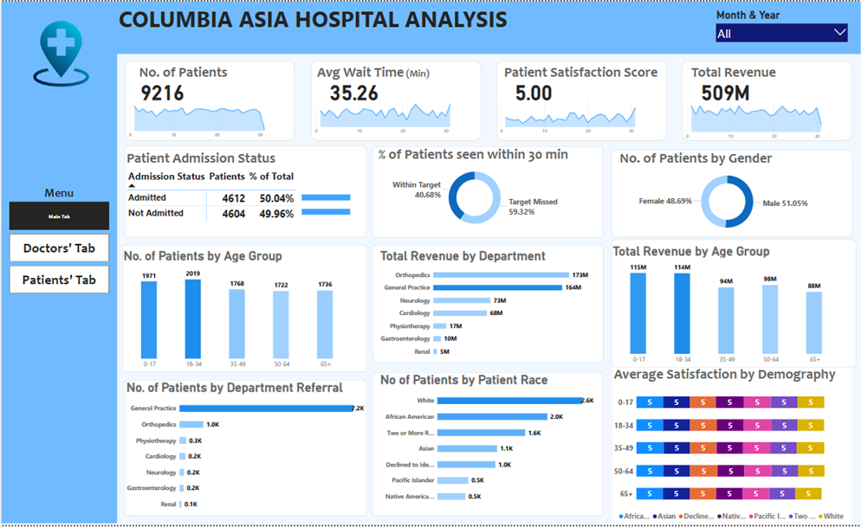
Final Dashboard (Main Tab)

Slide 21
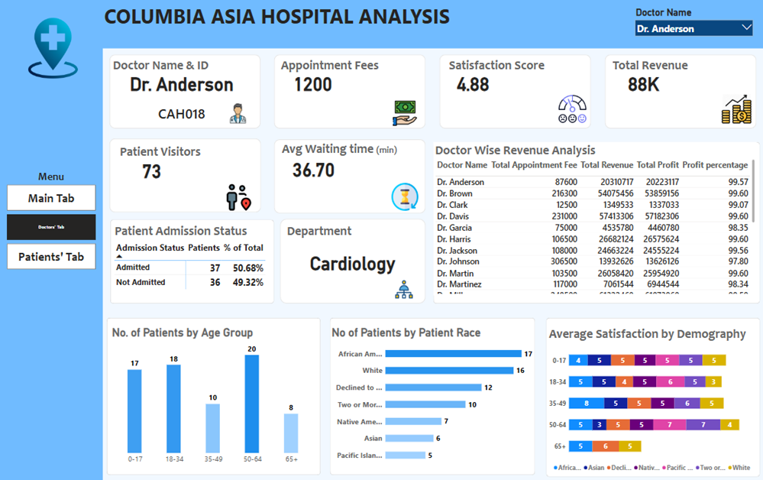
Final Dashboard (Doctors’ Tab)

Slide 22
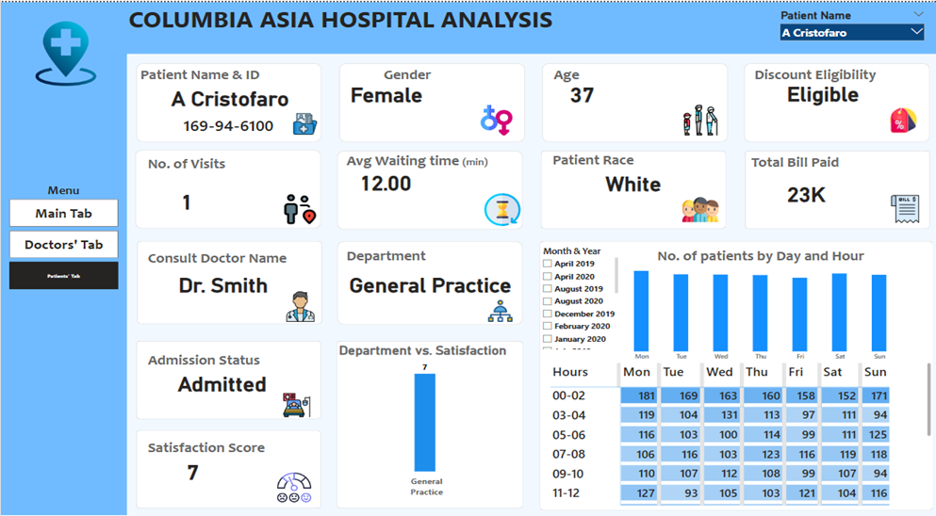
Final Dashboard (Patients’ Tab)

Slide 23
Conclusion
Focus on high-demand department efficiency and tailored patient satisfaction initiatives to enhance patient experience and revenue.
Leverage targeted discounts to improve retention, especially among cost-sensitive patients.
Enhance staffing, service customization, and financial incentives to elevate care, boost satisfaction, and drive revenue growth.
Consistent implementation will strengthen operational performance and the hospital’s reputation.

Slide 24
Thank You

